Slide 1
Monthly performance overview
Name of course here
Template

Slide 2
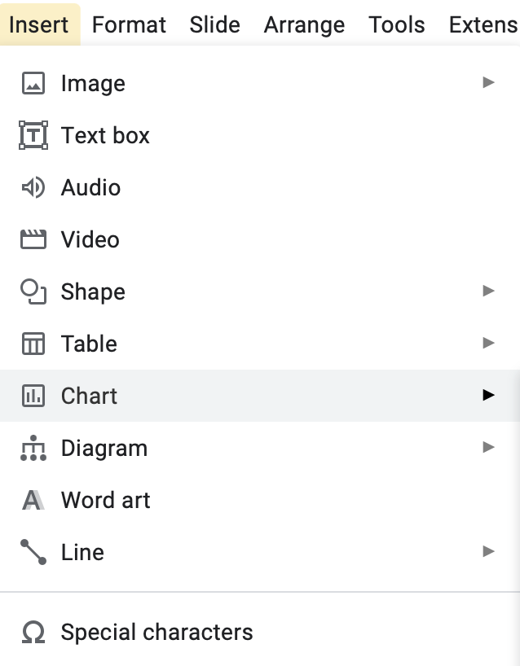
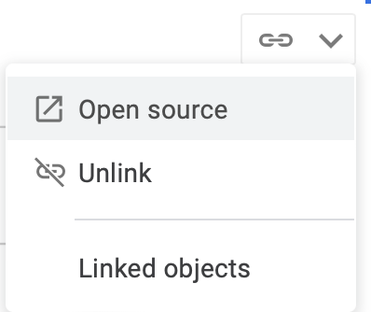
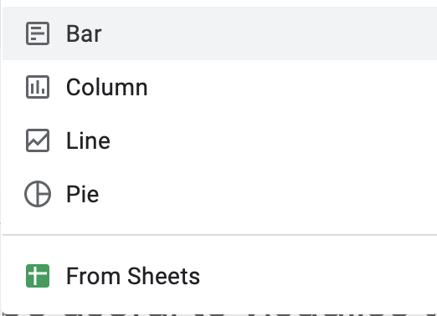
Notes
This template is a guide with suggestions - you’re welcome to add as many metrics as you find relevant to your organization (but remember, sometimes short and sweet does the trick!)
It can also be useful to visualize the information. You can add slides with graphs using the following input on Google Slides. Once you’ve created a chart, edit it by selecting “open source” in the top right of the chart.

Slide 3
[Insert month] KPI updates
Metric | Number | vs previous month | Year to date value | % to target
# of sales | X | % change from previous month | YTD | % to target
Total revenue | $X,XXX,XXX | % change from previous month | YTD | % to target
Upsell/cross-sell revenue | $X,XXX,XXX | % change from previous month | YTD | % to target
Profit | $X,XXX,XXX | % change from previous month | YTD | % to target
Forecast | $X,XXX,XXX | % change from previous month | YTD | % to target

Slide 4
[Insert month] KPI updates
Monthly revenue (example chart)
$1,100,000
$1,050,000
$1,000,000
$985,000
$1,000,000
$950,000
$950,000
$900,000
January
February
March

Slide 5
[Insert month] conversion updates
Metric | Number | vs previous month | Year to date value | % to target
Lead to conversion | X:Y | Change from previous month | Average YTD | % to target
Total leads | X | % change from previous month | YTD | % to target
Total opportunities | X | % change from previous month | YTD | % to target
Total negotiation | X | % change from previous month | YTD | % to target
Total proposal | X | % change from previous month | YTD | % to target
Total wins | X | % change from previous month | YTD | % to target

Slide 6
[Insert month] team updates and shoutouts
Metric | Team member | Number
Most deals closed | John Doe | X
Biggest deal closed | Jane Doe | X
Most leads | Mary Smith | X
Most outbound calls | Joe Bloggs | X

